Slide 1
CBSE Group 2
Component Model Demo

Slide 2
Introduction
Demonstration of functionality

Slide 3
Metadata
Added to messages passed between client/server
XML representation
Added before the bundle description ->parsed by the receiver

Slide 4
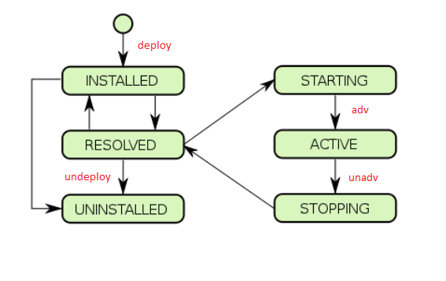
Lifecycle Management

Slide 5
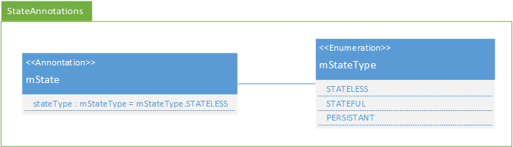
State - Annotation
@mState(stateType=mStateType.STATEFUL)

Slide 6
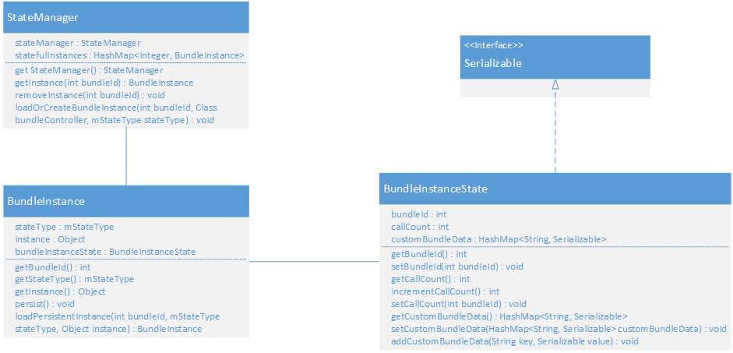
State - Instance Management

Slide 7
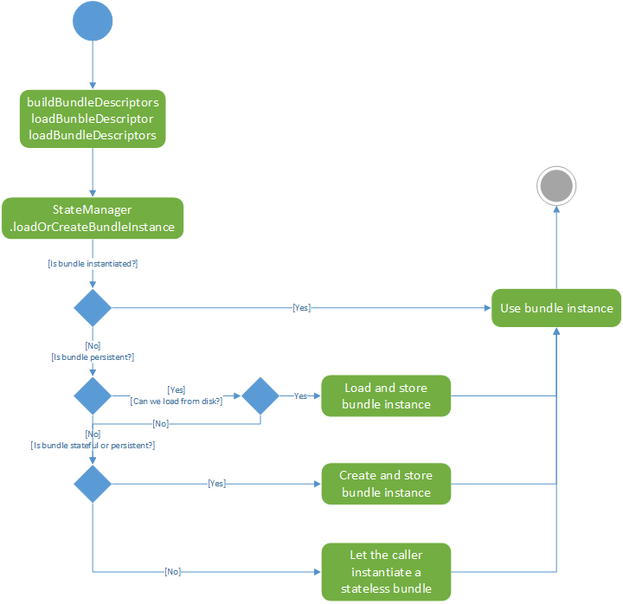
State - Instantiation

Slide 8
Security Management
Aspect Oriented Programming
Access-Granting
Access Checking

Slide 9
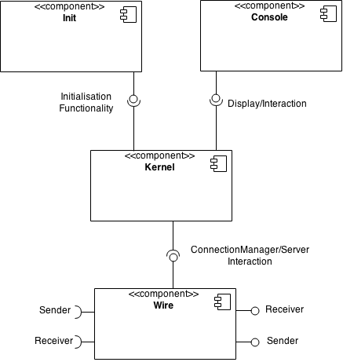
Abstract Overview

Slide 10
Conclusion
Any Questions?

